Slide 1

PayDay Loans and Predatory Lending
Jewish Family Service of Greater Dallas
Presented by:
Susie Stonecipher,
Senior Relationship Manager First Horizon Bank
April 7, 2022

Slide 2
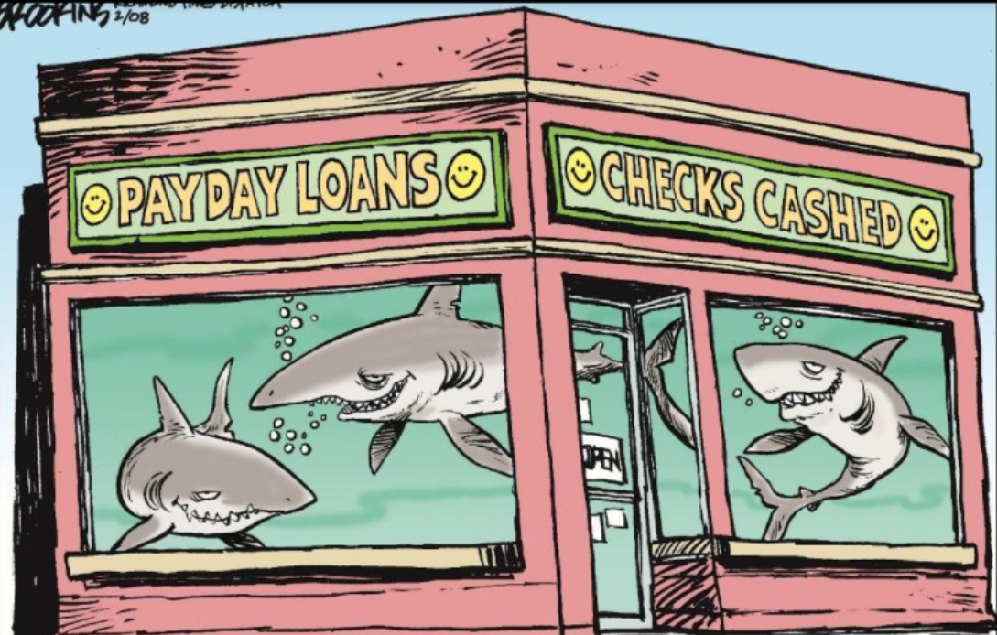

Slide 3
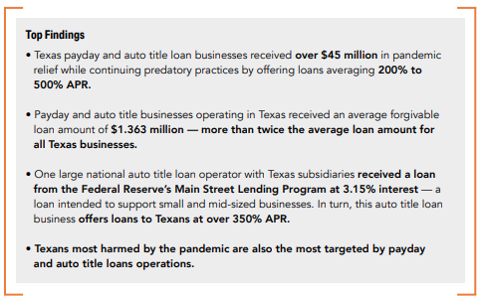
Character of PayDay Lenders

Slide 4
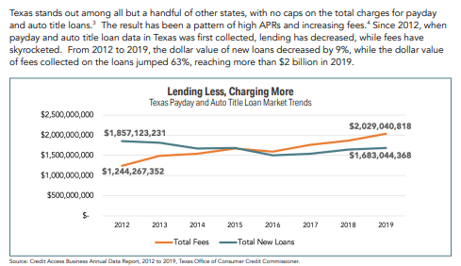
Fees vs Loan Amount

Slide 5
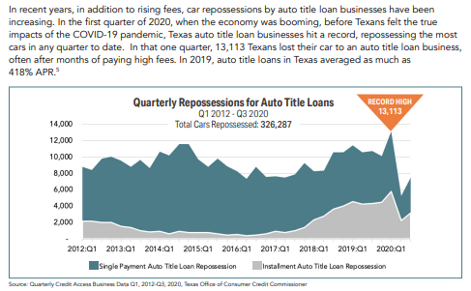
Auto Repossessions

Slide 6
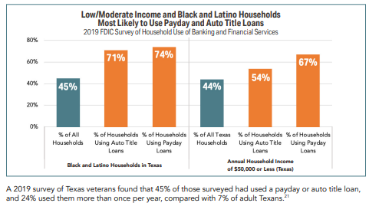
Most Affected Populations

Slide 7
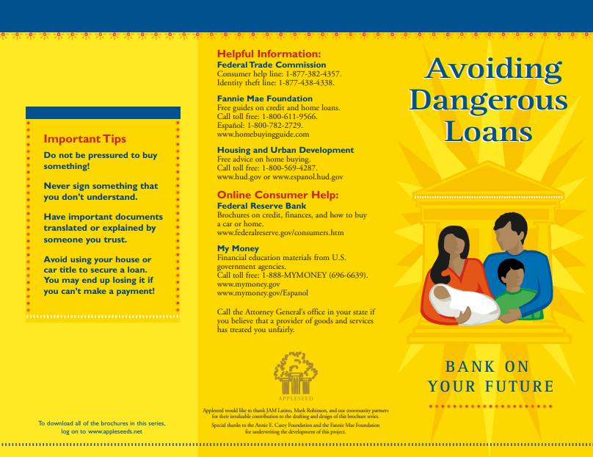

Slide 8
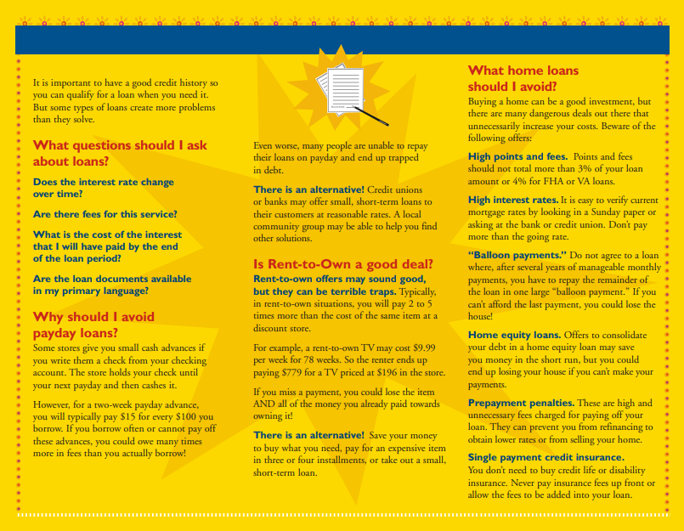

Slide 9
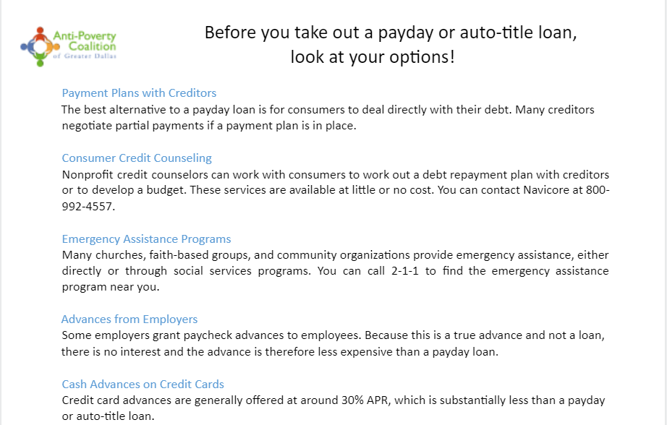

Slide 10
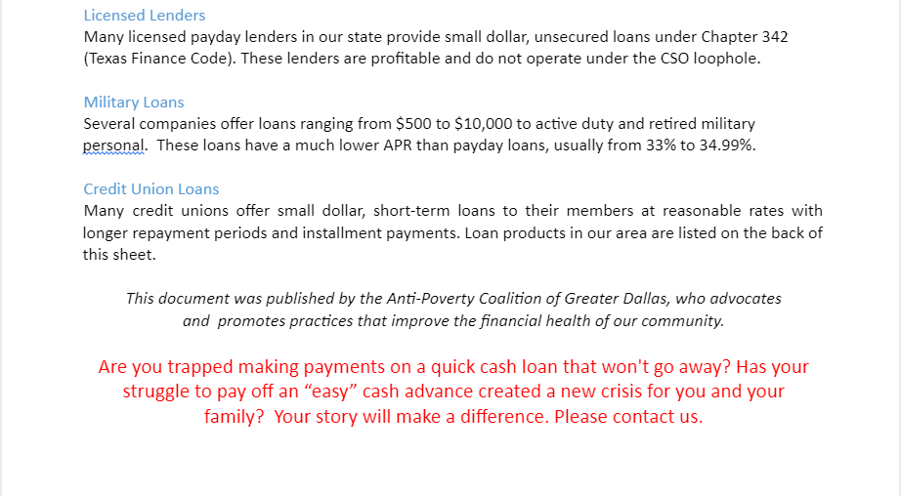

Slide 11
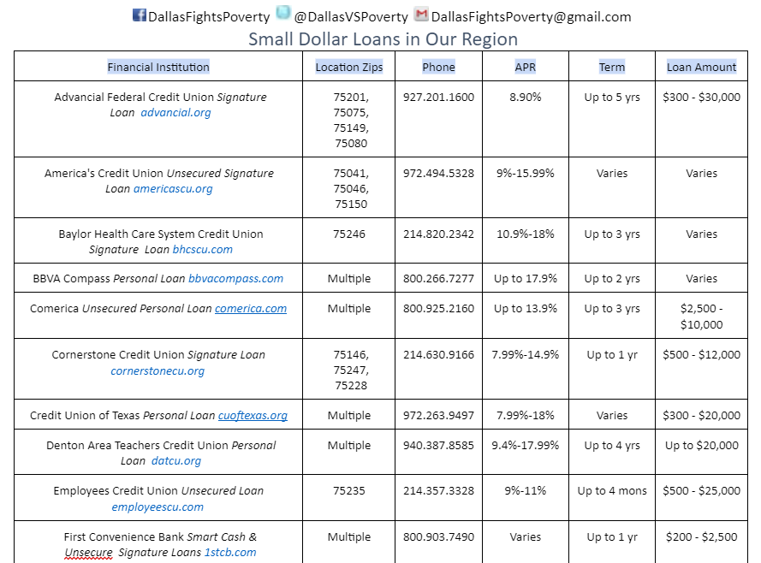

Slide 12
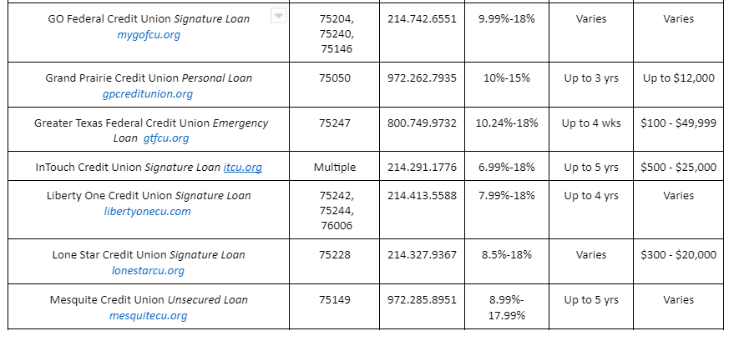

Slide 13
