Slide 1


Lending Webinar
Pamela Rivas
Andrew Pedigo

Slide 2
Presenter’s Biography
Pamela Rivas (Assistant manager):
Assistant Manager with CIT Bank
10 years of personal and business banking experience
Moved to the DFW in 2011 from California
Participated in other CRA events helping people in the community with sound banking advice
Andrew Pedigo (Universal Banker):
Universal Banker at CIT Bank
8 years of Banking experience
CRA Events, Financial literacy teaching, CIT Cares
UNT Student -currently Accounting major

Slide 3
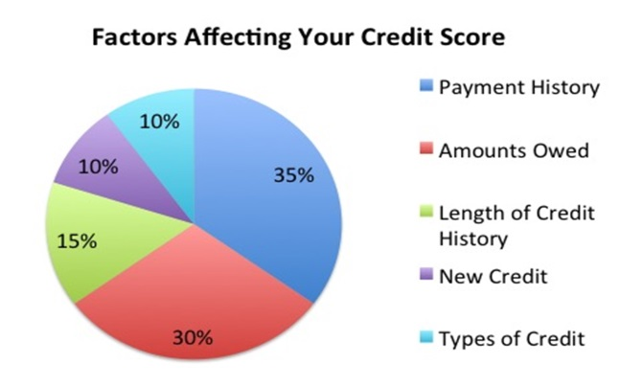
Have you been thinking about applying for a loan but have questions on factors that affect approval.
What is the Minimum credit score for a bank loan?
Depends on the financial institution and type of loan being requested
General information
Bad credit: 0 to 580
Fair credit: 580 to 669
Good credit: 670 to 739
Very good credit: 740 to 799
Exceptional credit: 800 to 850
Is credit score the only factor for a loan approval ?
Payment History
Length of Credit History
New Credit
Credit mix
Current debt

Slide 4
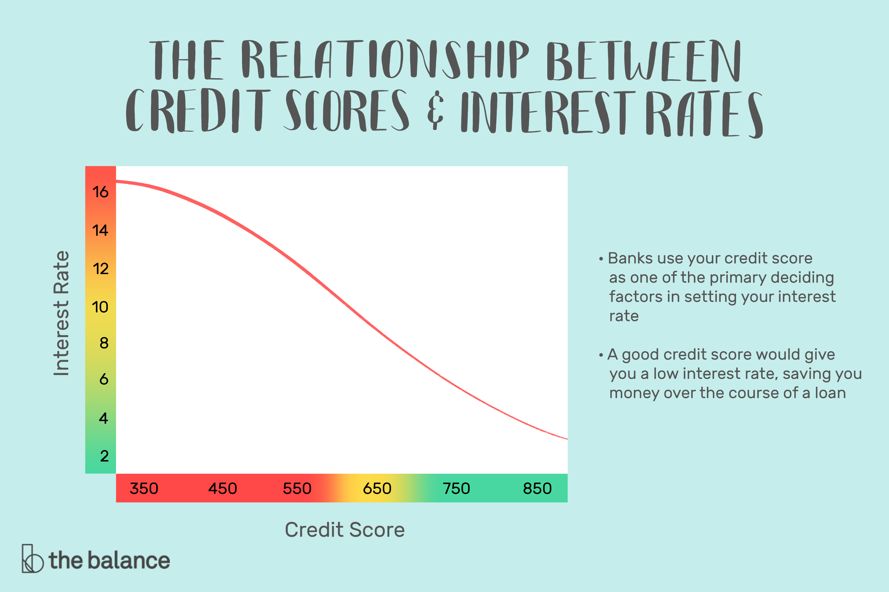
How does my overall credit report influence my interest rate ?

Slide 5
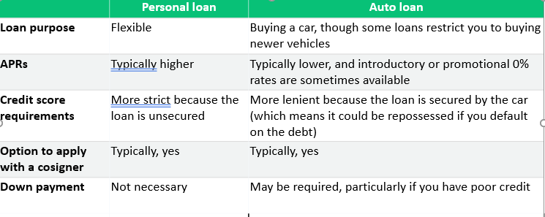
Is it easier to get a car loan than an unsecured personal loan?
In most situations, an auto loan is more preferrable than a personal loan when purchasing a vehicle: (LendingTree)
It is easier to qualify for an auto loan
Your interest rate will likely be lower
You’re less likely to have to pay other loan fees

Slide 6
If your car is paid off, can I refinance the loan to borrow against the equity?
WEIGH THE PROS AND CONS
Compare the pros and cons to make a better decision
Pros
Anyone (with a car) can qualify
Quick cash
You keep the car
Cons
High-interest rates
You could lose your car
Repossession may not be the end

Slide 7
Can I pay off high interest credit card balances with a debt consolidation loan ?
Debt consolidation loans move high-interest debts (including credit card balances) into a single, often lower-interest, payment. Per the Consumer Financial Protection Bureau (CFPB), consolidation may be a way to simplify or lower payments. However, it is important to remember that it does not erase your debt.
1. Balance transfer card
2. Credit card consolidation loan
3. Home equity loan or line of credit
4. 401(k) loan
5. Debt management plan

Slide 8
How can I prepare to apply for a mortgage loan ?
Start saving for a down payment between 15-20% of the price of the home that you would like to purchase.
Pay off existing debt
Build or repair your credit score
Check out current rates
Gather financial documents when ready

Slide 9

Q & A
Andrew Pedigo
E: Andrew.Pedigo@cit.com Phone: 214-257-7552
Pamela Rivas
E: HelenPamela.Rivas@cit.com Phone: 214-257-7550

